Slide 1
Data Collection

Slide 2
The Data
Historical crop yield data from Manitoba (2002-2022).
Municipal boundary data in GeoJSON format.

Slide 3
Data Preprocessing
Cleaning Crop Data: Handling missing values, correcting data types, and selecting relevant features for analysis.
Preparing Geospatial Data: Loading GeoJSON municipal boundaries, ensuring correct Coordinate Reference System (CRS), and simplifying geometries for efficient processing.
Year Risk Area / R.M. Crop Soil Farms Acres Yield/acre(Metric)
1 2004 PIPESTONE CANARYSEED F 8.0 1180.0 0.449 Tonnes
3 2009 MORRIS CANARYSEED D 3.0 1072.0 0.444 Tonnes
6 2003 PIPESTONE CANARYSEED F 8.0 1422.0 0.430 Tonnes
9 2002 CARTIER CANARYSEED D 24.0 4124.0 0.420 Tonnes
10 2004 GRASSLAND CANARYSEED D 4.0 1350.0 0.412 Tonnes

Slide 4
Exploratory Data Analysis (EDA)
Yield Trends Analysis: Visualization of historical yield trends to identify patterns and anomalies.
Spatial Distribution Analysis: Initial exploration of crop yields across municipalities to detect spatial patterns of productivity.

Slide 5
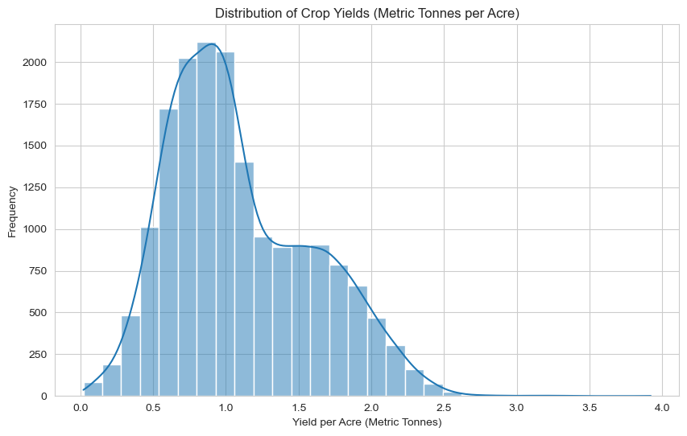
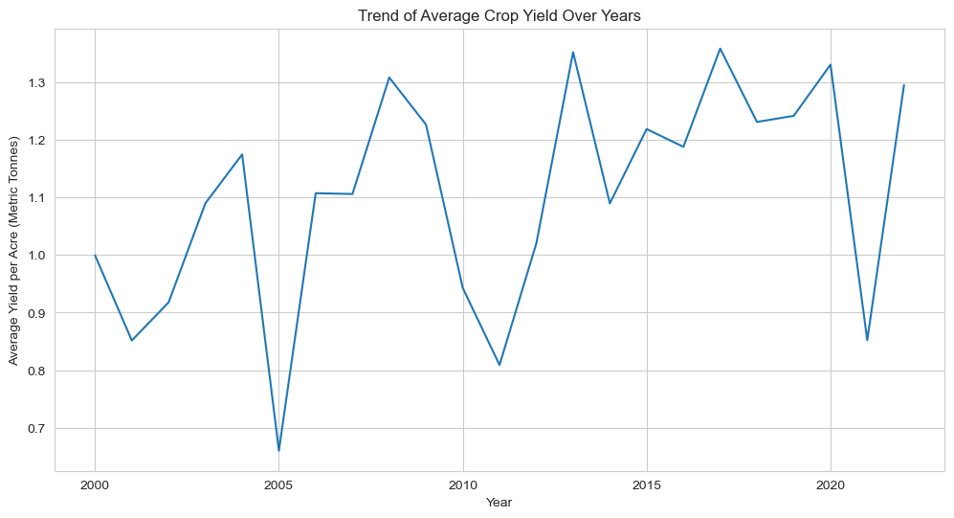

Slide 6
Integrating Spatial Data
Merging Datasets: Combining crop yield data with municipal boundaries based on common identifiers to enable spatial analysis.
Feature Engineering: Enhancing the dataset with derived features, including average yields and environmental factors if available.

Slide 7
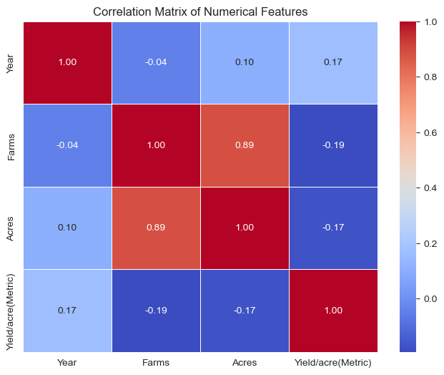

Slide 8
K-Means Clustering for Pattern Recognition
Objective: To group municipalities based on yield patterns and other relevant features.
Results Visualization: Mapping cluster assignments to visualize spatial distribution and identify areas with similar yield characteristics.

Slide 9
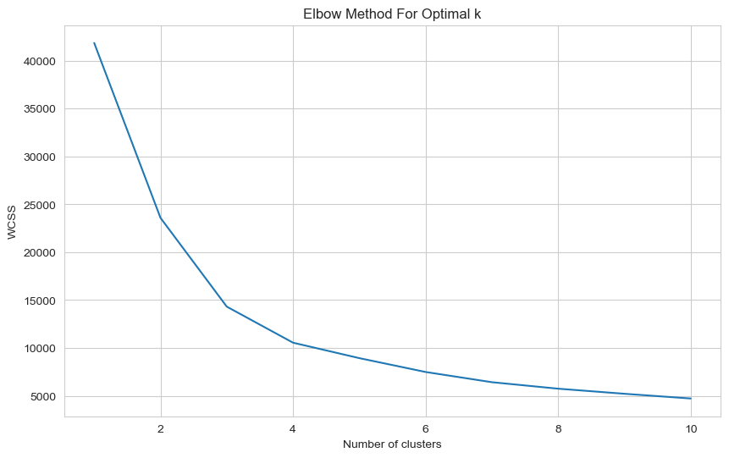

Slide 10
Predictive Modeling
Model Development: Applying RandomForestClassifier to predict crop failures, using cluster labels and other features.
Evaluation: Overview of model performance, highlighting accuracy and potential for operational use in predicting crop failures.

Slide 11
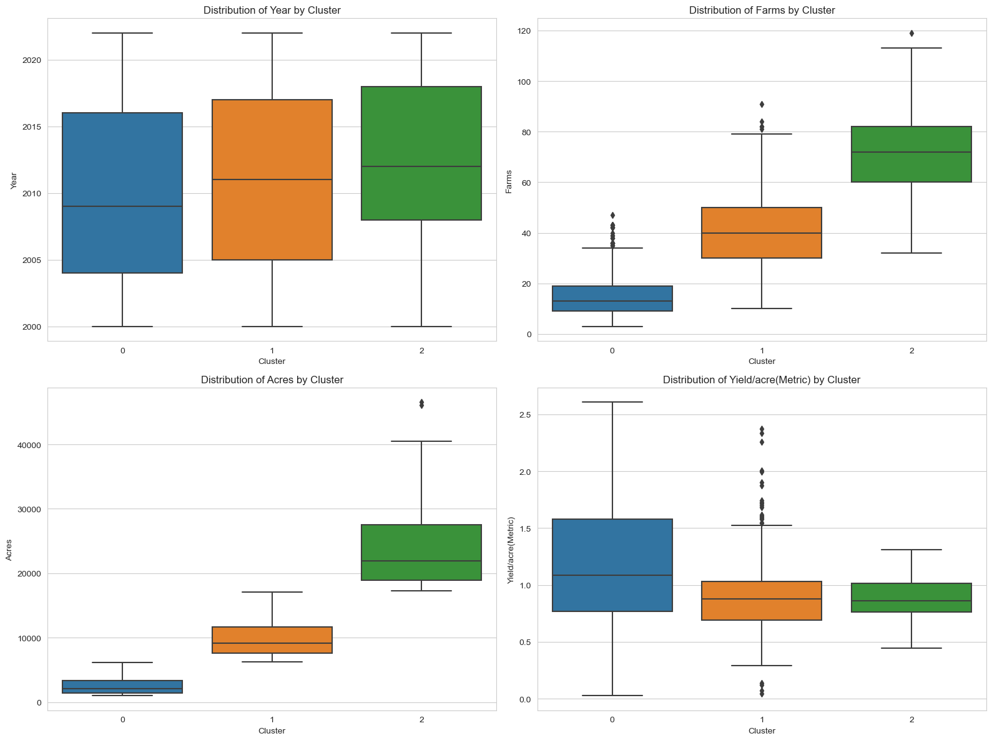

Slide 12
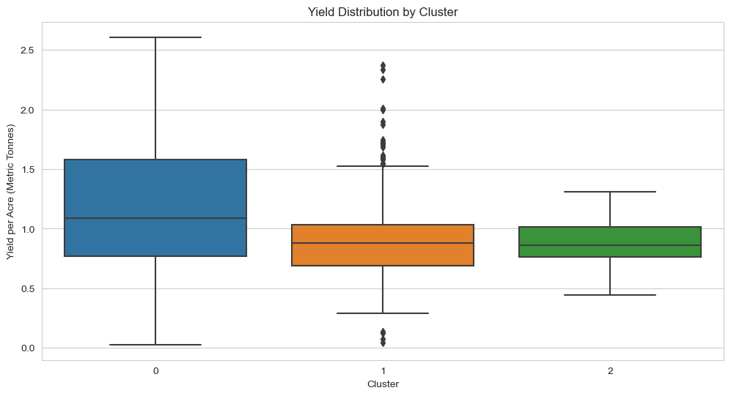

Slide 13
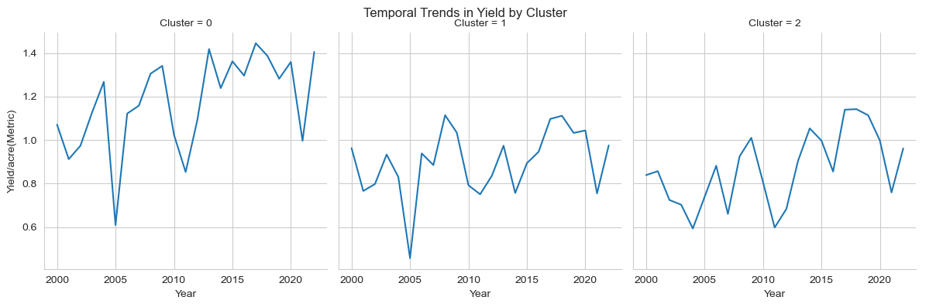

Slide 14
GIS Analysis
Spatial Join Techniques: Incorporating additional geographic layers for enriched analysis, such as proximity to water sources or elevation data.
Cluster Analysis: Examining the characteristics of each cluster, focusing on average yields, to identify high-risk areas for crop failure.

Slide 15
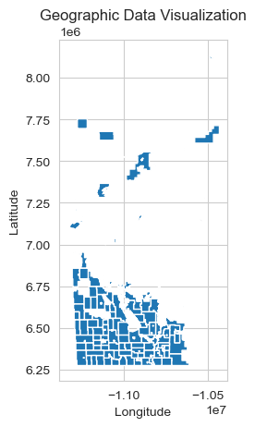

Slide 16
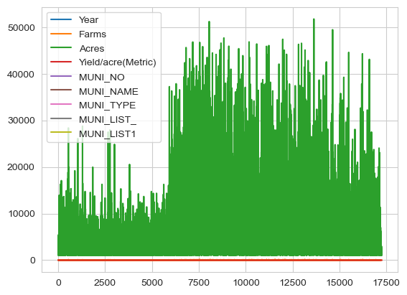

Slide 17
Recommendations for Crop Failure Mitigation
Targeted Interventions: Focusing resources and interventions on municipalities identified as high risk through clustering and predictive analysis.
Best Practices: Agricultural practices tailored to the specific conditions and challenges of the identified clusters.
Policy and Support: There should be policy measures and support mechanisms to enhance resilience against identified risk factors.

Slide 18

Final point
A one-line description of it

